Slide 1
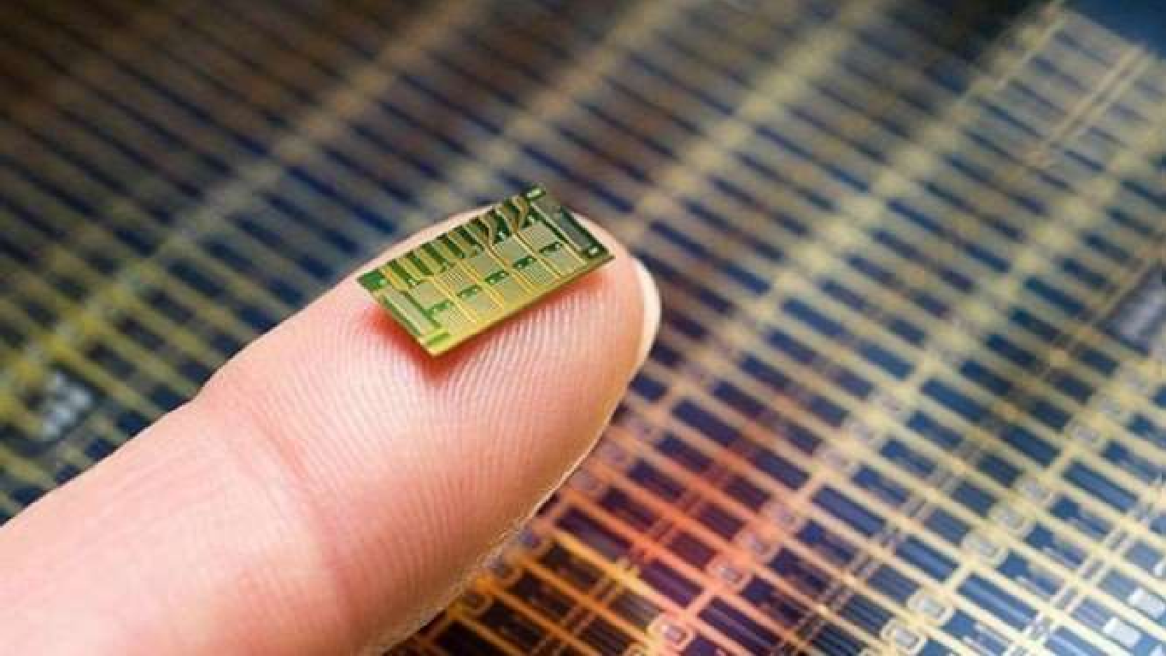


NANO BIOSENSORS AND INTERNET OF NANO THINGS
Presented By
PRADAKSHINA
SREE VARSHINE
1

Slide 2
BIOSENSORS
BIOSENSORS
These are analytical devices , which measures concentration of an analyte.
In biosensors , a biological material (such as enzyme, antibody,
whole cell, nucleic acid) is used to interact with the analyte.
2

Slide 3
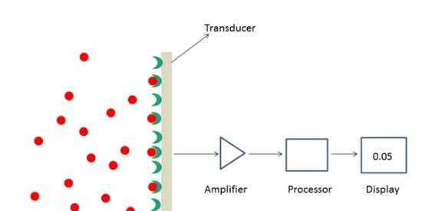
COMPONENTS OF A BIOSENSOR
Bio elements (Analytes)
Bio receptors (Biological component)
Transducer
Electronic system
Analyte
Bio receptors
3

Slide 4
APPLICATIONS
BIOLOGICAL APPLICATIONS
1.DNA Sensors:Genetic monitoring,Desease 2.Immunosensors:HIV,hepatitis,other viral deseases,drug testing etc. 3.Cell based sensors:Functional sensors,drug testing...
Point-of-care sensors:Blood, urine, electrolytes, gases, steroids, protiens,hormones,etc.
Bacteria sensors:Food industry,medicine,environmental,others
Enzyme sensors:Diabetics,drug testing,etc.
ENVIRONMENTAL APPLICATIONS
Detection of environmental pollution and toxicity.
Agricultural monitoring 3.Ground water screening 4.Ocean monitoring
4

Slide 5
INTERNET OF NANO THINGS (IONT)
WHAT IS IONT?
IONT is the manifestation of a small-scale IOT systems that is an ideal solution for remote environmental monitoring and medical application.
It is a collection of sensor networks , data collectors and transmitters that send data from multiple entry points through the cloud into a centralized location.
5

Slide 6
IONT
HOW IONT SYSTEMS WORK?
Components in IONT network communicate with each other to
transfer data over long distance.
There are two ways of communications:
Through the transmission of electromagnetic waves.
Through molecular communication which uses information
that has been stored and encoded within the molecules.
6

Slide 7
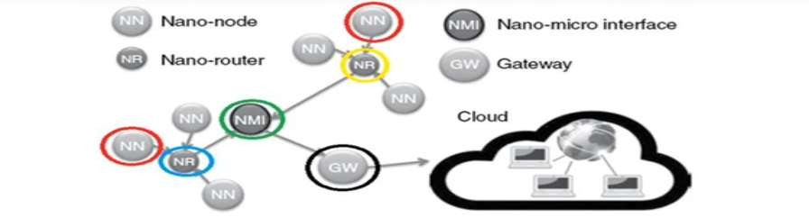
IONT
BASIC COMPONENTS OF AN IONT SYSTEMS
NANONODES
NANOROUTERS
GATEWAYS
NANO-MICRO INTERFACE DEVICES
7

Slide 8
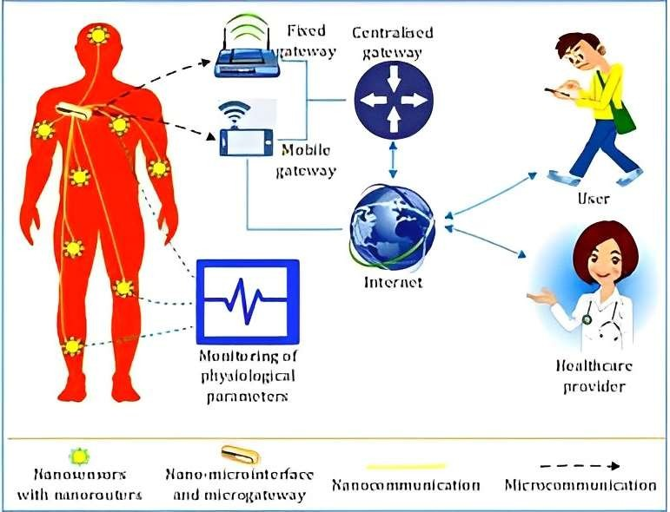
IoNT ARCHITECTURE
8

Slide 9
IONT COMMUNICATION
COMMUNICATION IN WIRELESS NANOSENSORS:
COMMUNICATION OPTIONS FOR WIRELESS NANOSENSOR N/W
MOLECULAR COMMUNICATIONS
NANO-ELECTROMAGNETIC
COMMUNICATIONS
DIFFUSION BASED
FLOW BASED
WALKWAY
BASED

Slide 10
APPLICATIONS
Food analysis
Study of biomolecules and their interaction
Drug development
Medical diagnosis
Environmental field monitoring
Quality control
Industrial process control
Detection systems for biological warfare agents
Manufacturing of pharmaceuticals and organ replacements.

Slide 11
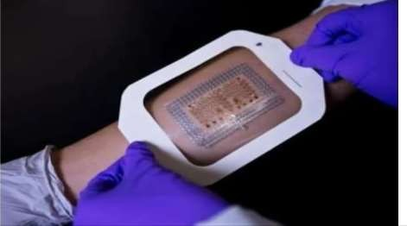
CURRENT RESERCH (WEARABLES)
Measure glucose level.
Hyperglycemia triggers the delivery of Metformin.
patch can connect to portable analyser.
Data can be sent to smartphone or tablet
Activated when sufficient sweat is detected
Measures metabolite & Electrolyte level of healthy person
Alert-Dehydration,fatigue & rising body temperature

Slide 12
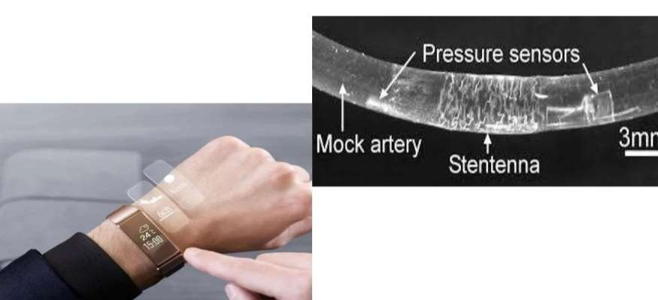
WEARABLE & IMPLANTABLE

Slide 13
CHALLENGES
.Limited computational capabilities.
.Limited memoy space.
.Designing lightweight protocols.
.Compatibility and Integration
.Sensor Validity and Temperature control
.Security and Privacy
.Health consequences:implanting electronic devices with radiating signals inside the human body is still a concern for the scientists and medical experts.(can overcome by using IoBNT)

Slide 14


